Slide 1



UNIT 6; The time of your life
Patience

Slide 2
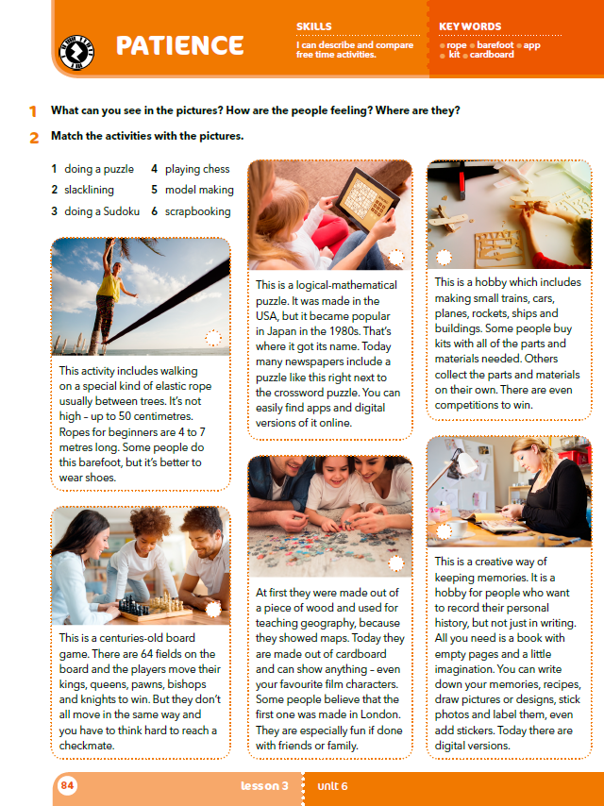
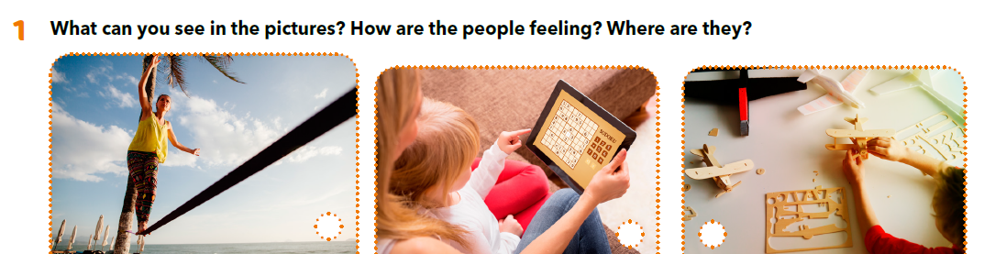
Are all free time activities safe?
Why is it good to have a hobby?
Can you name some safe/dangerous/unusual hobbies?

Slide 3

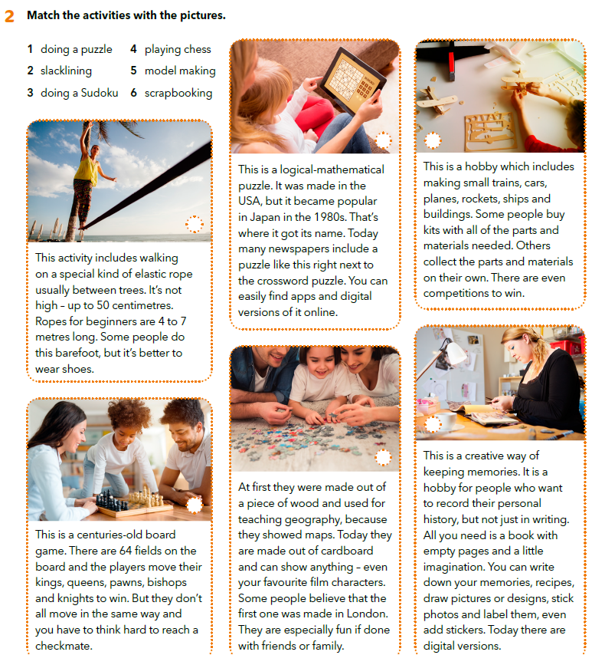
3
5
Have you tried any of these activities?
Which one do you think is the most interesting?
Which of them is the most exciting?
Which one of these activities do you think is the oldest?
Can you do all of them alone?
2
6
1
4

Slide 4
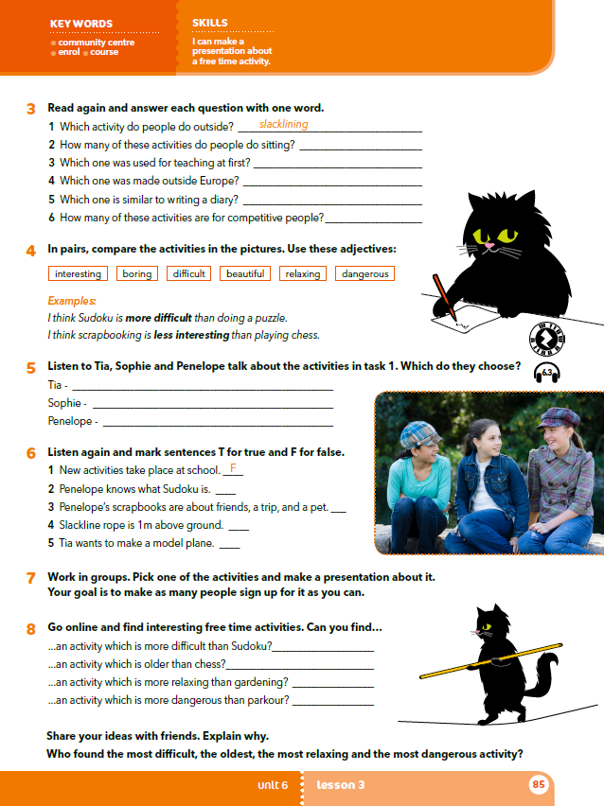
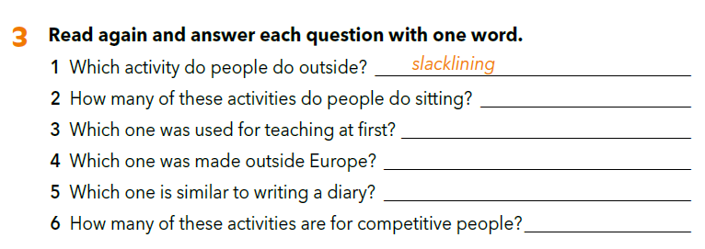
five
puzzle
Sudoku
scrapbooking
two
Let’s practise: https://wordwall.net/play/929/633/358

Slide 5

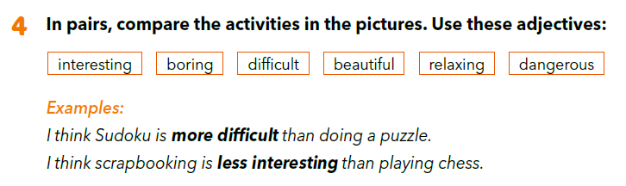
Let’s practise:
https://wordwall.net/resource/929752/engleski-jezik/f2-u6l3-comparation

Slide 6
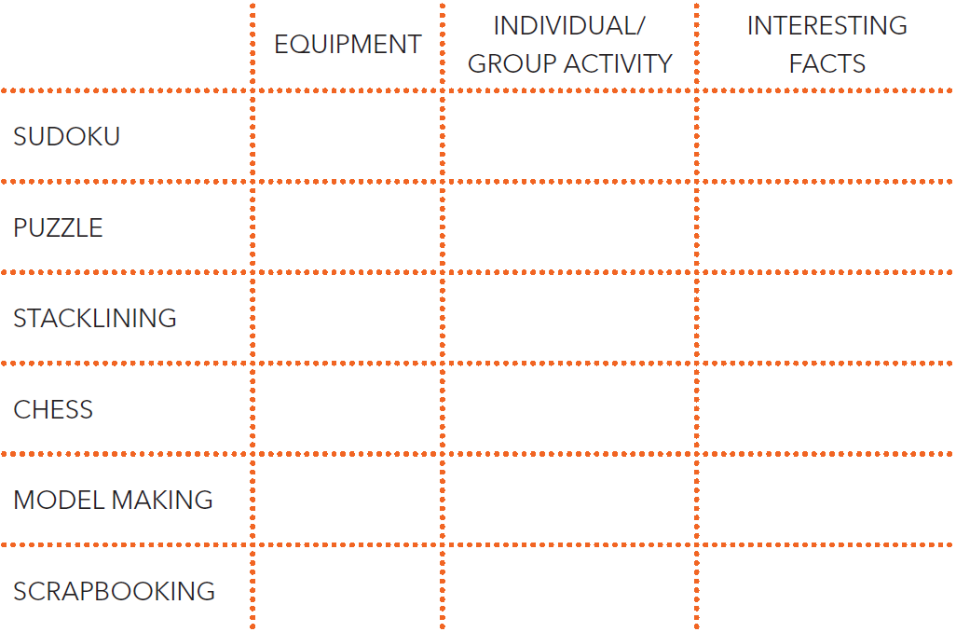
Fill in the table.

Slide 7
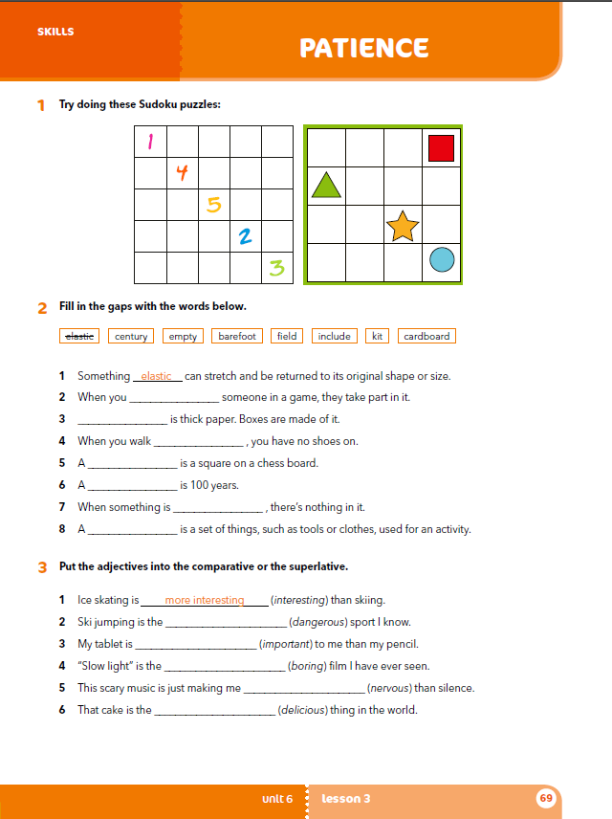
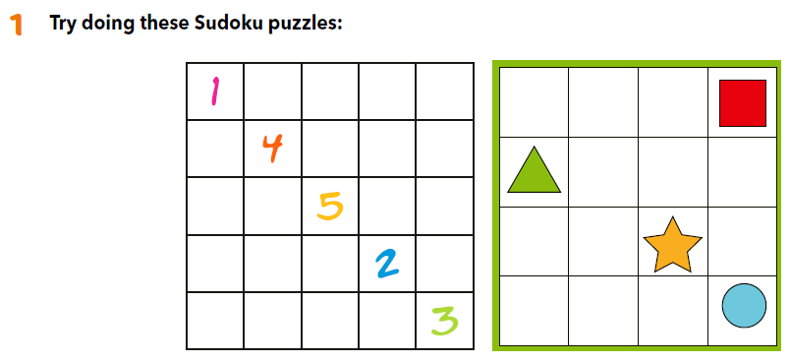
Workbook, p. 69

Slide 8
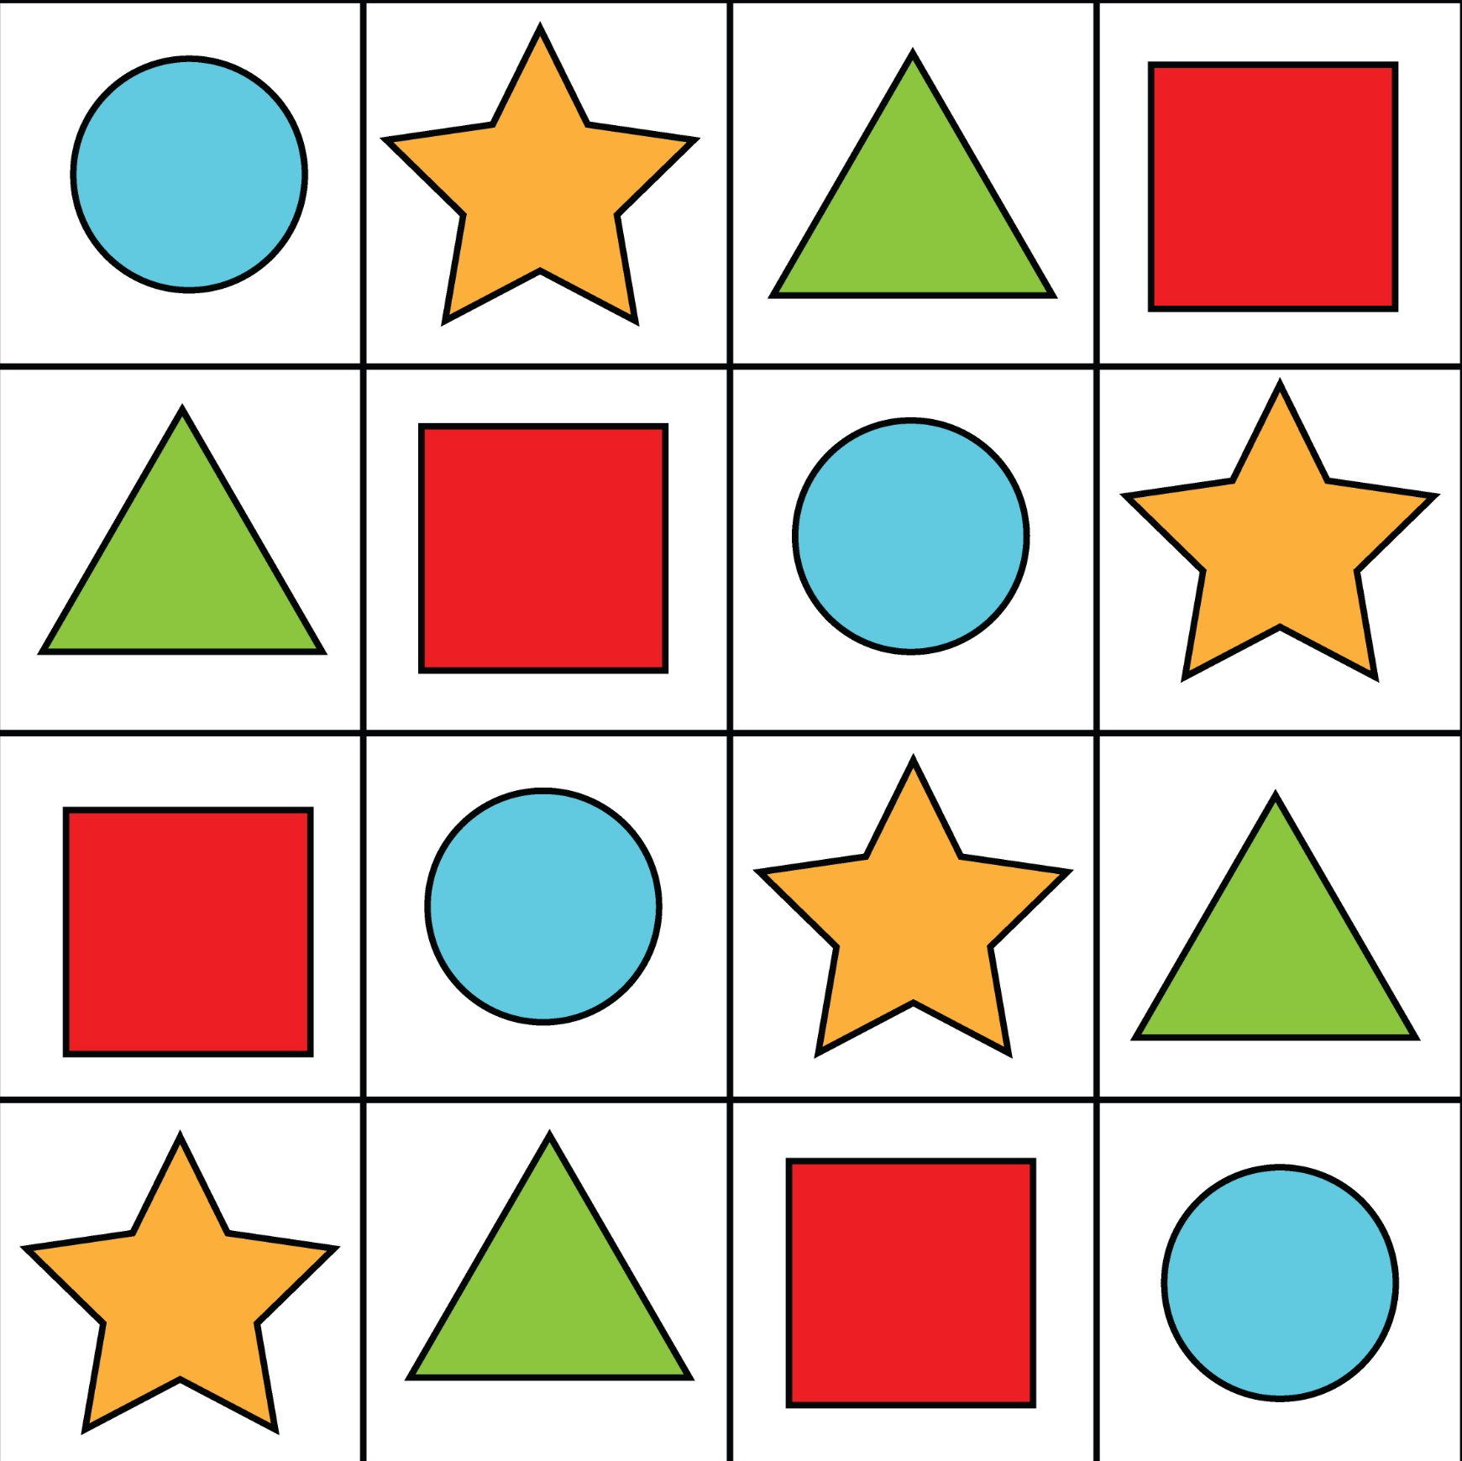
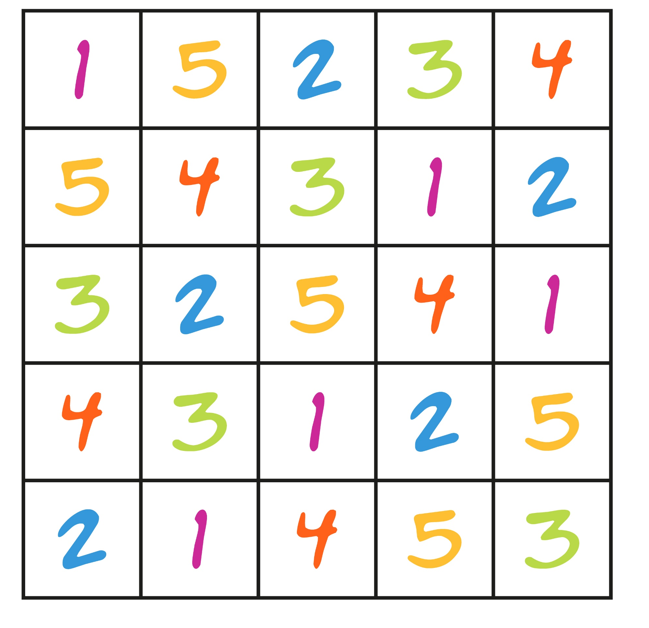
Let’s check!

Slide 9

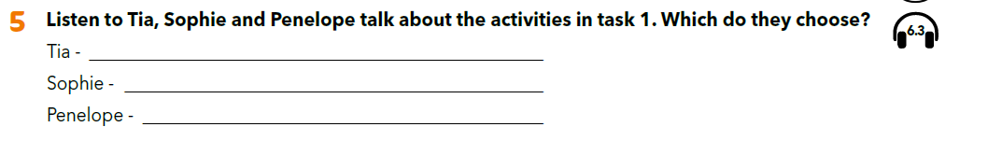
Was there an activity that you heard about for the first time?
Which activity do you find most interesting?
Which do you think is most dangerous?
What do you think is more exciting, model making or scrapbooking?
model making
scrapbooking
slacklining

Slide 10
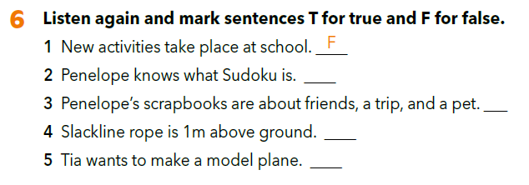
F
T
F
T

Slide 11
Where can the girls enrol in new activities?
What does Penelope think about Sudoku?
What does Tia like better, Sudoku or model making?
What is Sophie’s favourite activity?
What would you choose?
What do you like better, physical activities or puzzles?

Slide 12
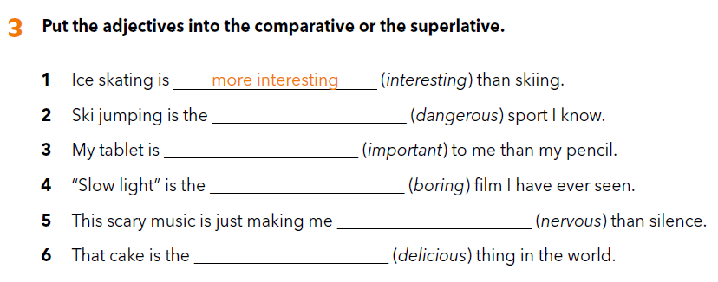
Workbook, p. 69
most dangerous
more important
most boring
more nervous
most delicious

Slide 13
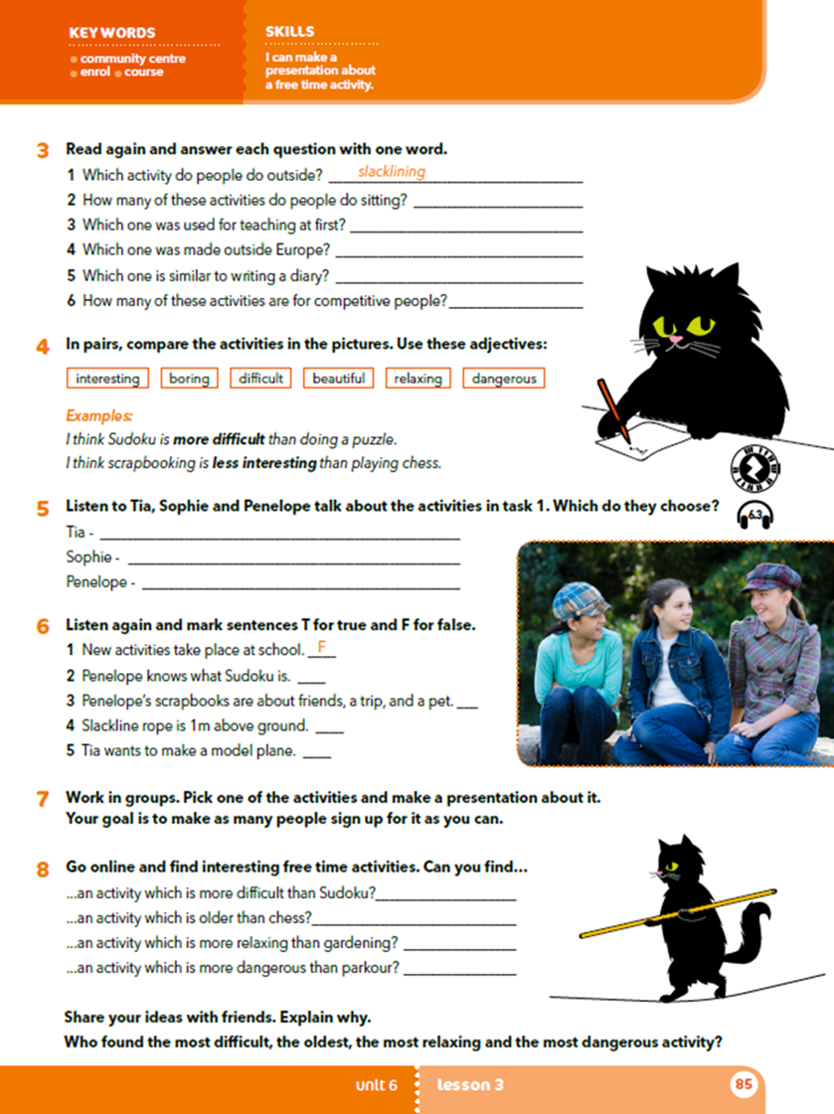
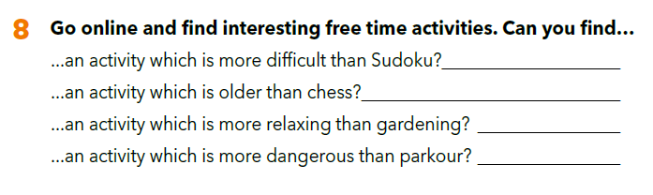

Slide 14
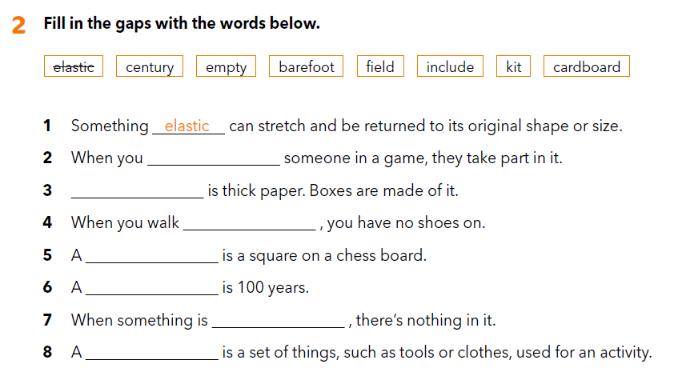
Workbook, p. 69
include
Cardboard
barefoot
field
century
empty
kit

Slide 15
• name of the activity
• type (physical, intellectual, creative…)
• level of difficulty
• how dangerous it is
• how relaxing it is
• who it is for
• why people should take it up.

